Slide 1


Business Meetings and Minutes of Meeting
Week 14
Business Communication 218
Ms. Bakhtawar Halepoto

Slide 2
Overview
Meetings In Business
Types of Meeting
Attending Meetings
Notice and Agenda
Chairman’s Agenda
Minutes of Meeting
Final Practical-1

Slide 3
Meetings In Business
Many meetings take place in business – an effective meeting is an efficient tool in the communication process.
Meetings enable face-to-face contact of a number of people at the same time.
Provide useful opportunity for sharing info, making suggestions and proposals, taking decision and obtaining instant feedback.
Active participation of all members is usually encouraged.

Slide 4
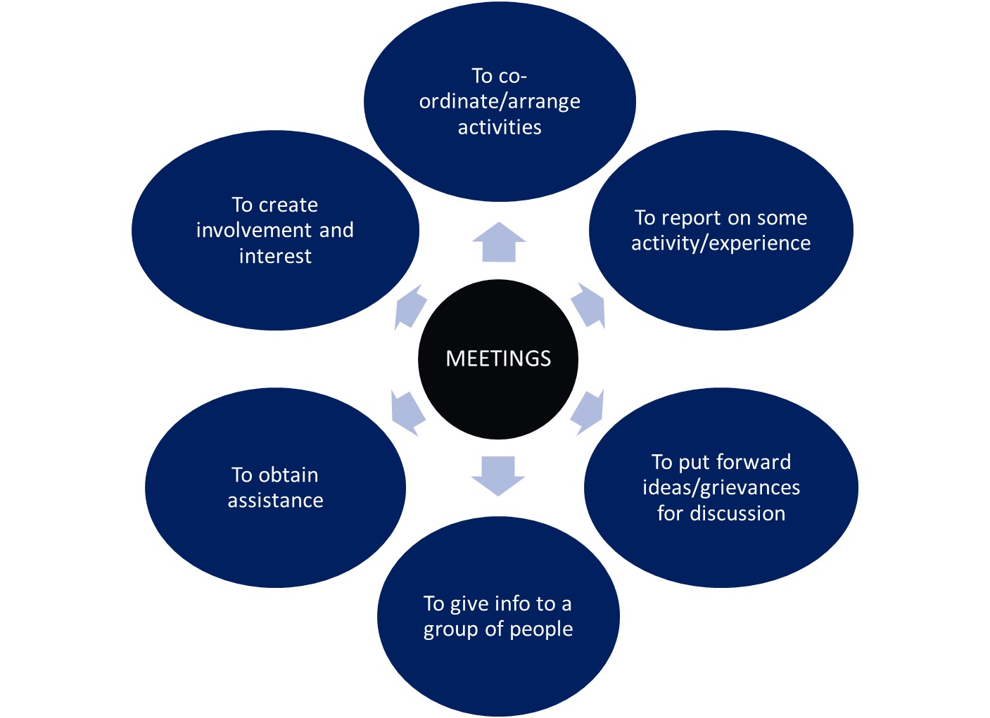
Meeting purposes

Slide 5
Types of Meeting
Formal Meetings
The rules of conduct are laid down in a company’s Articles of Association and/or Constitution or Standing Orders.
A quorum must be present, - the minimum number of people who should be present in order to validate the meeting.
A formal record of these meetings must be kept.

Slide 6
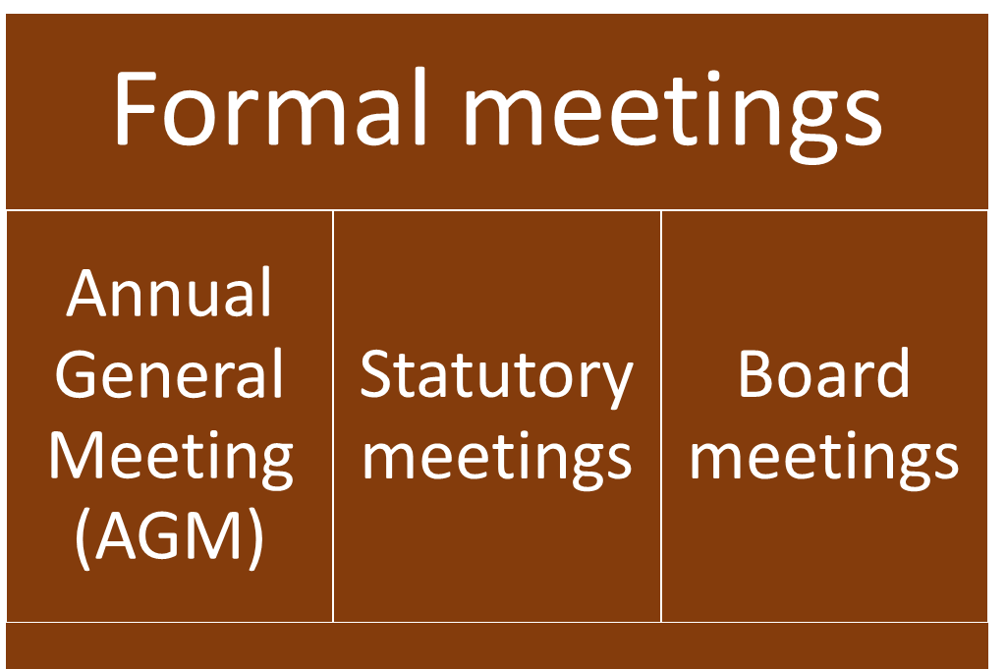

Slide 7
Formal meetings
1. Annual General Meeting (AGM)
Is usually held once a year to assess the trading of the organization over the year
All shareholders are invited to attend the AGM but they must be given 21 days’ notice

Slide 8
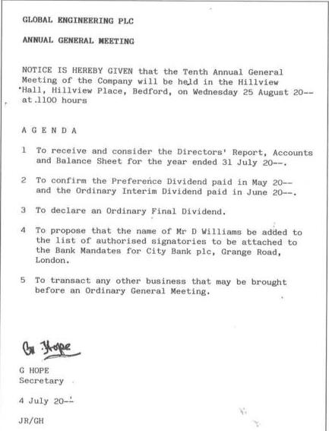
Annual General Meeting

Slide 9
Formal meetings
2. Statutory meetings
Statutory meetings are called so that the directors and shareholders can communicate and consider special reports.
Companies are required by law to hold these meetings.

Slide 10
Formal meetings
3. Board meetings
Are held as often as individual organizations require.
Attended by all directors and chaired by the chairman of the board.

Slide 11
Types of Meeting
Informal Meetings
Are not restricted by the same rules and regulations as formal meetings.
May take the form of brainstorming/ discussion sessions where strict agendas may not be necessary and minutes may not be kept.
However, it is good business practice for an agenda to be issued to all members prior to the meeting so that they can prepare adequately in order to make valuable contribution.

Slide 12
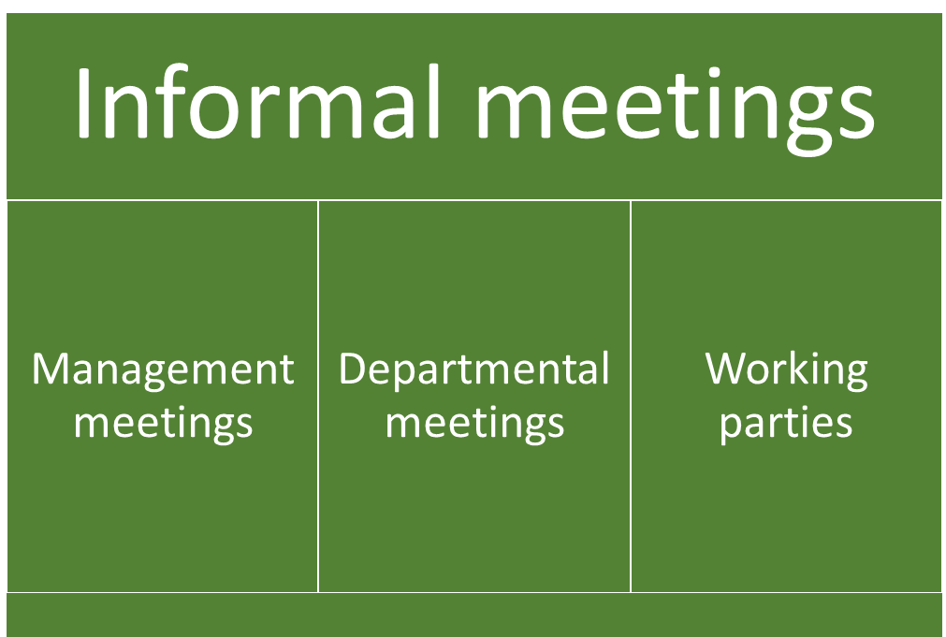

Slide 13
Informal meetings
1. Management meetings
Are attended by a group of managers who need to discuss specific matter, report on progress or receive progress reports.
E.g: The marketing manager, sales manager, production manager and r & d (research and development) manager may need to discuss the launch of a new product.

Slide 14
Informal meetings
2. Departmental meetings
Are called by the head of department or manager of a certain section.
All staff will be invited to attend so that info can be passed on or reports received from some members of staff regarding a specific project.

Slide 15
Informal meetings
3. Working parties
May be set up to work together on a specific project or problem. At meetings, progress reports will be given and decisions for further action taken.

Slide 16
Attending Meetings
Meetings account for 50-60 % of a manager’s time in business. When conducted efficiently, they are effective way of helping:
  Decision-making process
  Briefing teams
  Exchanging information
  Problem solving
However, it is a sad fact that many meetings are unproductive due to: poor management or being unsure of individual’s role in meetings.

Slide 17
Attending Meetings
As a member of any meeting, even if you are not the chairman, there is a lot you can do to make meetings effective:
1. Understand the purpose of the meeting, as well as your role and what is expected of you.
2. Read in advance. Make notes about any input you would like to make.
3. Don’t be a silent member. Give your opinions and take active part wherever possible.
4. Don’t interrupt anyone who is speaking.
5. Watch other members of the meeting and listen to them carefully.

Slide 18
Remember!
The success of any meeting depends largely on its leader. If the leader is well prepared, and if the members have been chosen carefully, the meeting should be productive.

Slide 19
Notice and Agenda
The success of a meeting depends on a variety of essential preparations. Important to ensure documentation is dealt with efficiently. The notice and agenda are usually combined in one document.
Top portion – notice
gives details of the type, place, day, date and time of the meeting

Slide 20
Notice and Agenda
Middle portion – agenda
list of topics to be discussed at the meeting.
Note that the first three and final two items are known as ordinary business. These are items which will be included on every meeting agenda.
After the opening items of ordinary business, there will be a list of special business – these are special matters to be discussed at this meeting only.

Slide 21
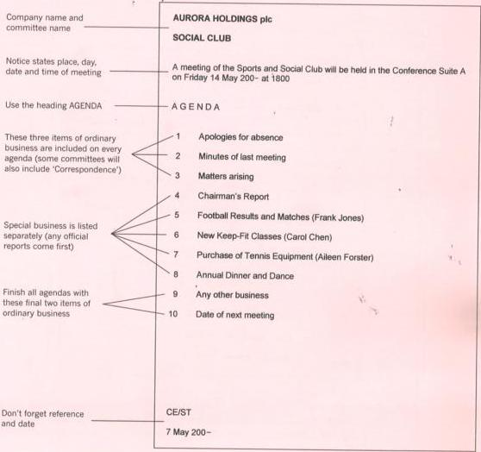
Notice and Agenda - sample

Slide 22
Chairman’s Agenda
The Chairman has an important responsibility to manage the meeting once it is in progress. In order for the Chairman to lead the meeting effectively, he/she may have a special Chairman’s agenda which contains extra notes for the Chairman to use when introducing each item.
It follows the same format as the notice and agenda but the right-hand side is left blank. This is where the Chairman will make notes of important points discussed during the meeting.

Slide 23
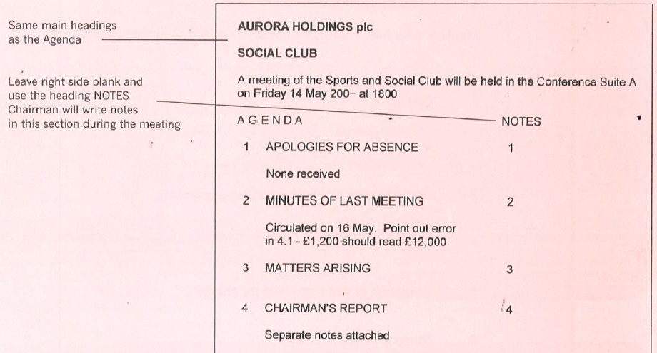
Chairman’s Agenda - sample

Slide 24
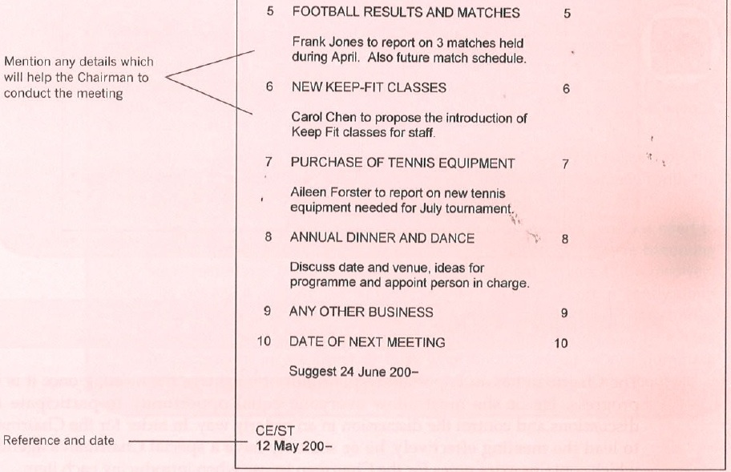
Chairman’s Agenda – sample cont.

Slide 25
Minutes of Meeting
An accurate written record of meetings is essential not only to those who attended but also for those who were unable to attend.
Types of minutes:
Verbatim minutes
Minutes of resolution
Minutes of narration

Slide 26
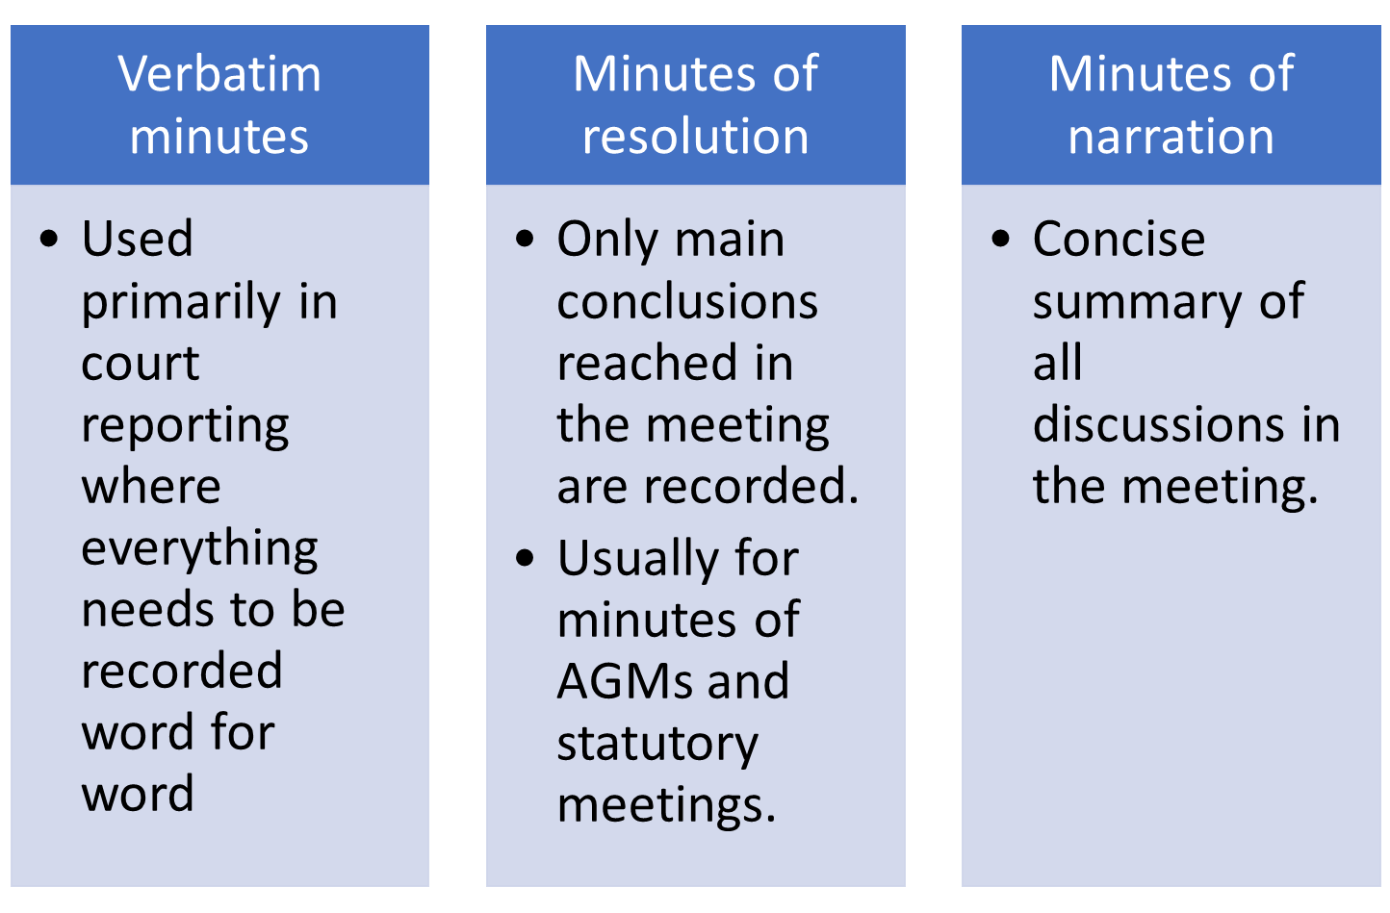
Minutes of Meeting

Slide 27
Layout and wording of minutes
Minutes may be displayed in a variety of formats depending on the preference of employer and organisation.
Should be written in past tense using third person and reported speech.

Slide 28
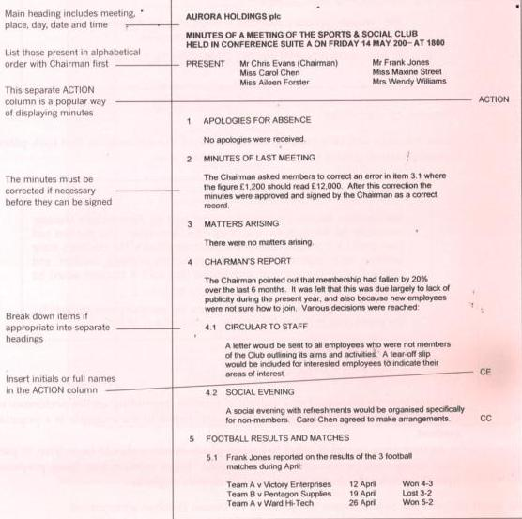
Layout and wording of minutes

Slide 29
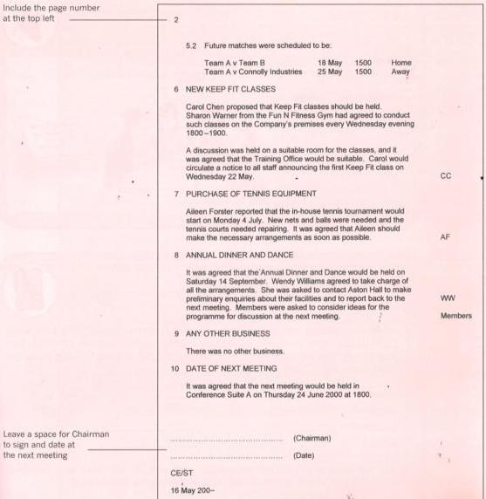
Layout and wording of minutes

Slide 30
Meetings – Key Points to Remember
A notice and agenda is sent out to give all members advance notice of a meeting.
An agenda is a list of topics to be discussed at a meeting.
Agenda should have ordinary business at the beginning and the end – business that is discussed at every meeting.
Special business will be included in the central section of the agenda – business that is unique to each meeting.
The Chairman may have a special agenda with extra notes to help him manage the meeting.

Slide 31
Meetings – Key Points to Remember
Minutes are a record of meeting and they are essential for everyone who attended as well as those who were absent.
Minutes may be presented in different formats depending on the preference of each company.
It is usual to include an ‘Action’ column stating who is responsible for dealing with each item.
The same headings should appear on the minutes as on the agenda.
Write minutes in past tense and third person using reported speech.

